Slide 1
Beast Mode
Chafic Charafeddine - Remy Dillenseger - Gregory Douglas - Jose Medina

Slide 2

A Marketplace Near You
Our goal was to be able to create a Marketplace dApp where people could register new artwork, view other people's collection, and have the option to buy and sell there NFTs all in one place.

Slide 3
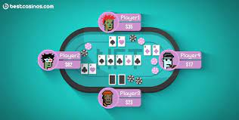
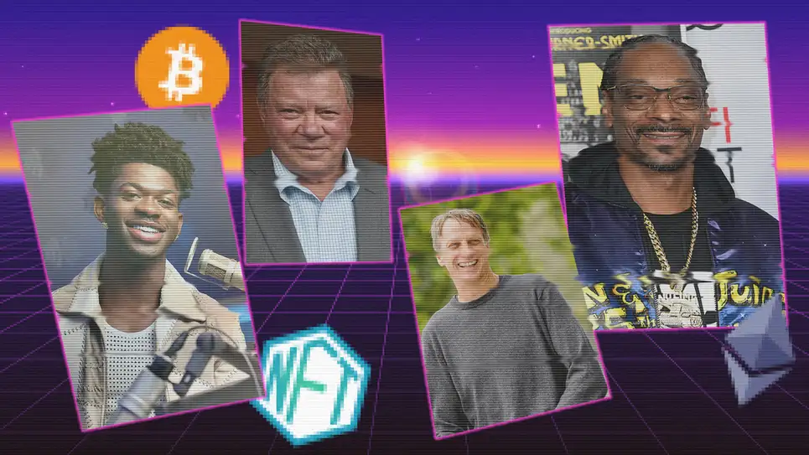
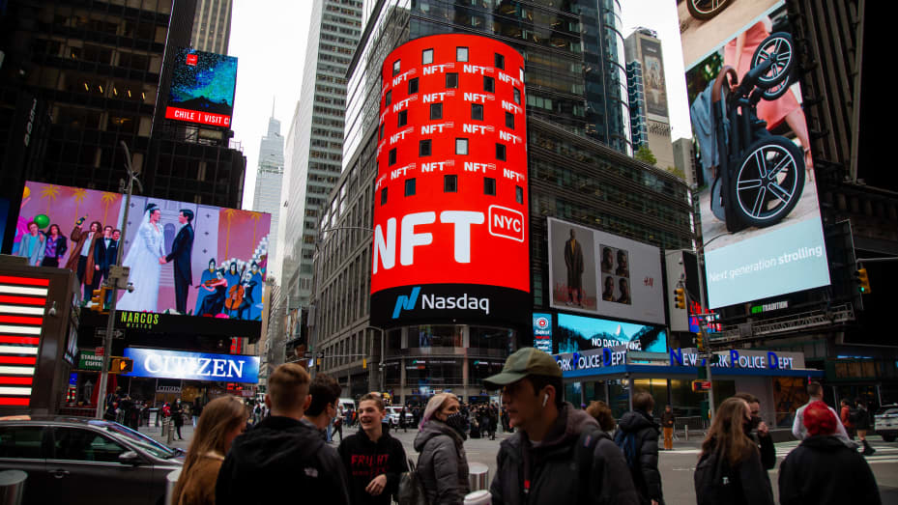
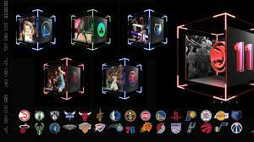
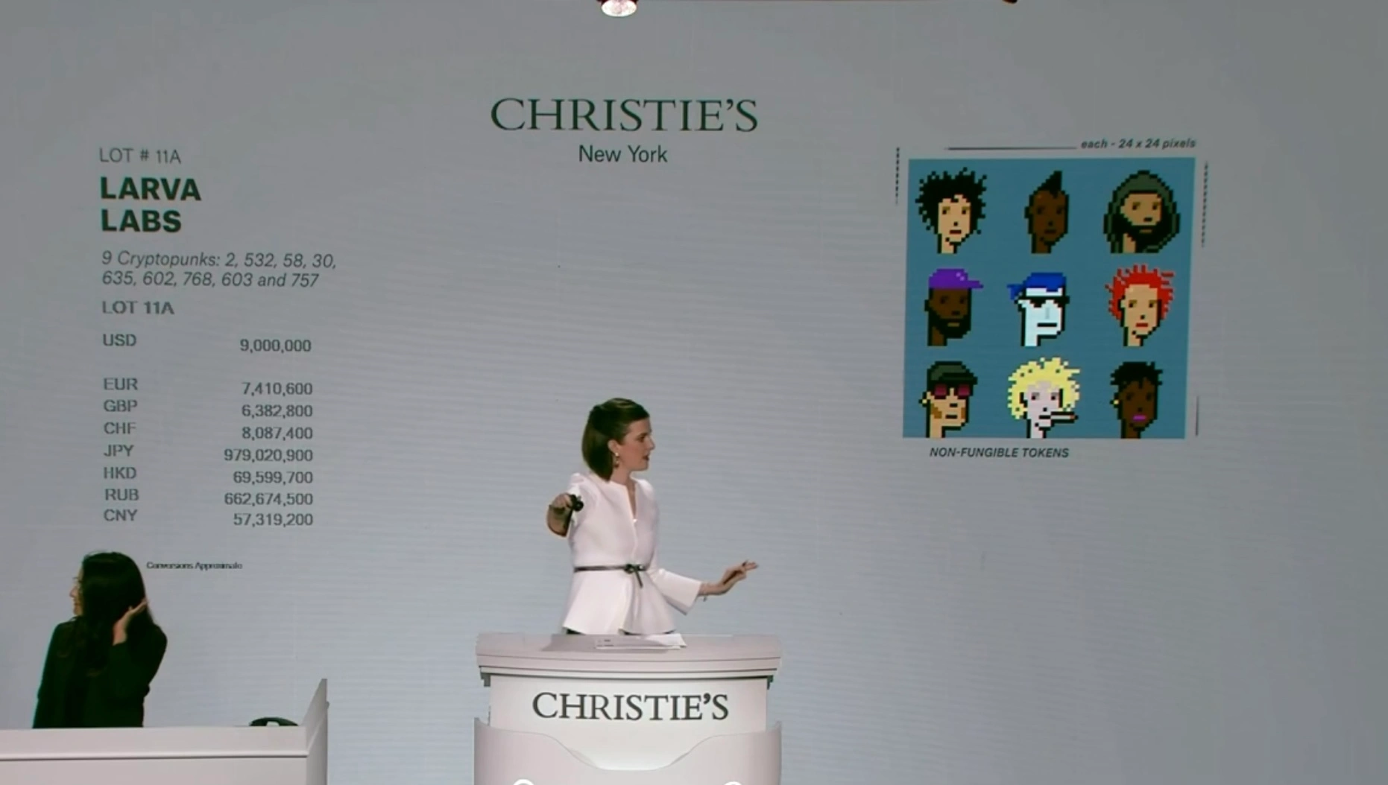

NFTs Everywhere

Slide 4

Tools of the Trade
Pinata
Streamlit/pages
Metamask
Ganache
Web3
IPFS
Remix
This Photo by Unknown author is licensed under CC BY-NC.

Slide 5

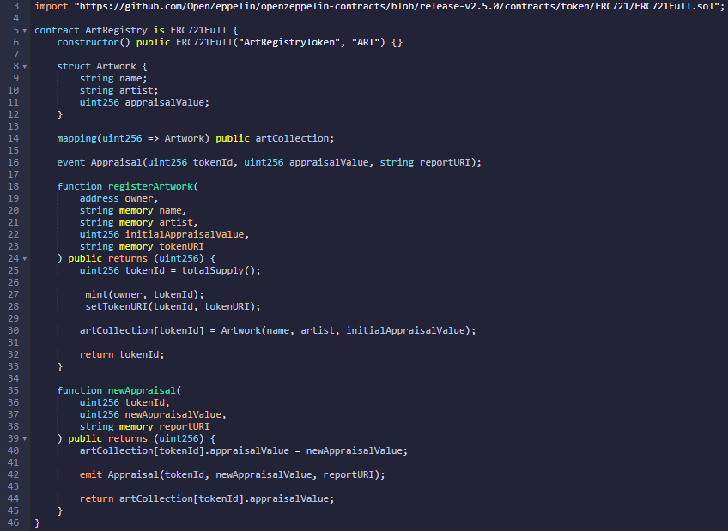

Slide 6
Demo

Slide 7


Challenges
Interpreting output from pinata
IPFS loading speed
ERC-721 token protocols

Slide 8

Streamlit upgrade
Eth mainnet
Buy/sell functionality
Cosmetic improvements
Improving picture load speed
Deploying (containerizing)
Accessibility

Slide 9

Security Improvements
Managing customers user credentials
Authentication & authorization
Contract Logic

Slide 10
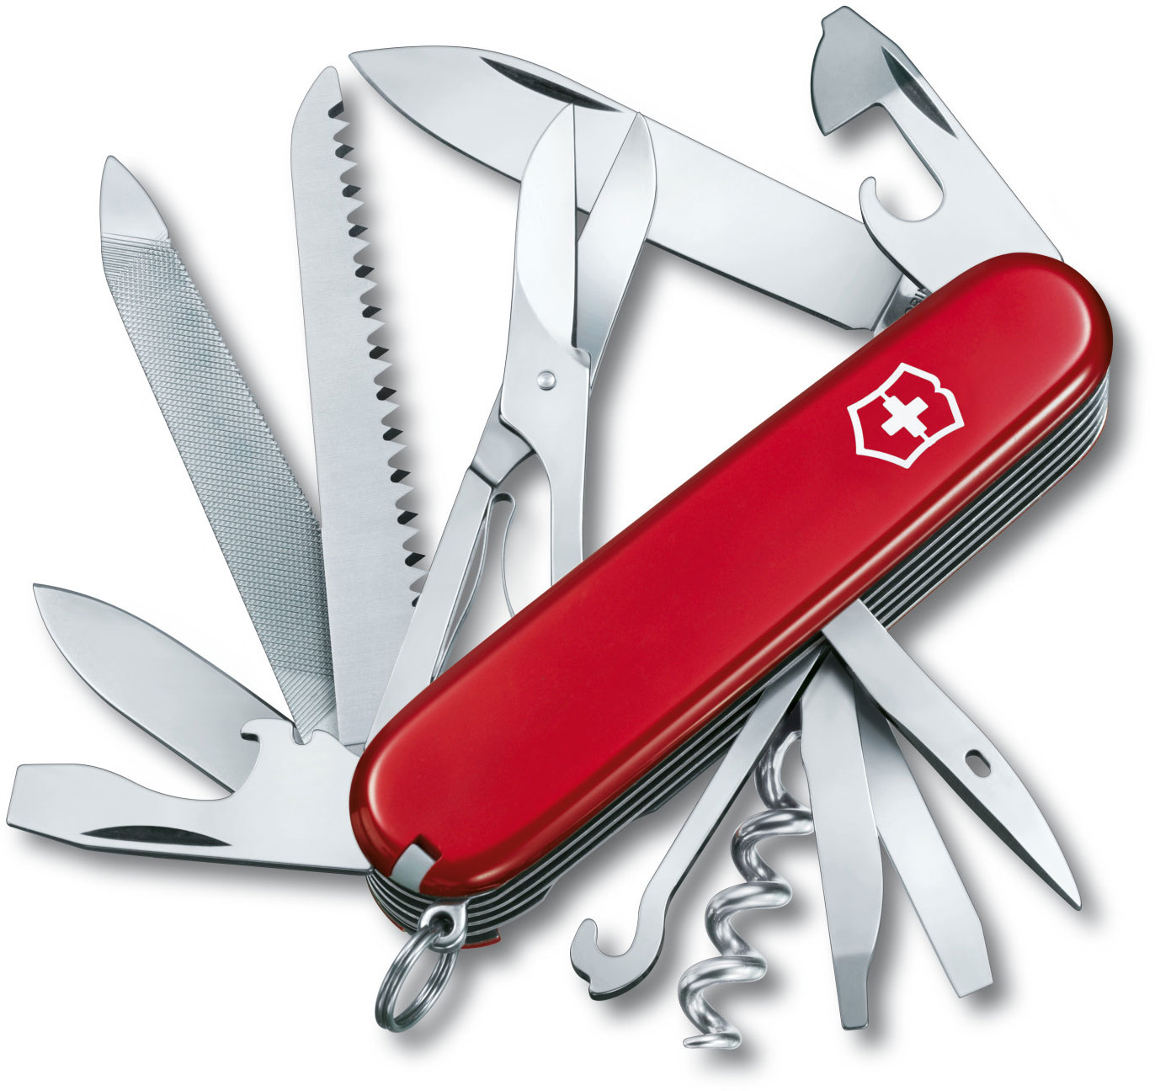
Extra Functions
Royalties, fee exemption and discounts
Access (membership, community,events)
Distribution of rewards
Flash loans

Slide 11
Fin

